Slide 1
Introduction to Mininet-WiFi exercise
Course 34351 Access- and Home Networks

Slide 2
Mininet-WiFi exercise
First mandatory exercises in course
Purpose: To experiment with different WiFi networks and to get a sense of the performance of WiFi in different scenarios
Plan:
Date | Topic
2025-02-13 | Introduction to Mininet-WiFi, Getting the software installed and tested
2025-02-20 | Exercise part 1
2025-02-27 | Exercise part 2
2025-03-06 | Wrap-up if there are parts you’re missing – otherwise work on your journal
2025-03-13 | Deadline for handing-in the journal to the assignment on DTU Learn @13.00

Slide 3
How can we evaluate network performance?
Measurements on a real (live) network?
Measurements on a test bed?
Build simulation (software) models of protocols and network nodes and run simulations
Emulate node functionality in software

Slide 4

Measurements on a live network: Pros and cons
Pros:
  Results are real and represents actual traffic
Cons:
  No control over traffic
  Results generally not reproducible
  Very difficult to test alternative
  configurations, topologies, etc.
Source: https://www.pcworld.com/article/533069/obama_web_traffic.html
Notes:
Re: Obama’s 1st inauguration: January 20, 2009

Slide 5
Measurements on a test bed: Pros and cons
Pros:
  Control of network traffic and results are normally reproducible on identical test beds
  Easier to test different configurations, topologies, ... than on a live network
Cons:
  May be difficult to change/modify software on network nodes
  May be expensive to set up for a bigger network
Notes:
Re: Obama’s 1st inauguration: January 20, 2009

Slide 6
Measurements using simulations
Pros:
  Possible to develop very detailed models
  Full control of everything
  Results are 100% reproducible
Cons:
  Can take a long time to develop many (complicated) models
  Impossible to implement every functionality in the network => Models are not complete
  Results are (usually) not identical to real systems
  But if you’ve carefully selected what to implement and what to leave out, you can still get useful results
      Especially if you use simulations to compare configurations, etc.

Slide 7
Emulation
Pros:
  You use actual code, e.g., actual Linux drivers
    Easy to test the performance of an updated driver
  Results are (almost) reproducible
  A powerful computer can emulate a large network (i.e. less resources than a test bed)
Cons:
  You use actual code, e.g., actual Linux drivers
    Bugs in the code affects your results
  Still some abstractions, e.g., models of communication links
  Very large networks may require a big computer (but still cheaper than a test bed)
  Often developed for a specific area of research

Slide 8
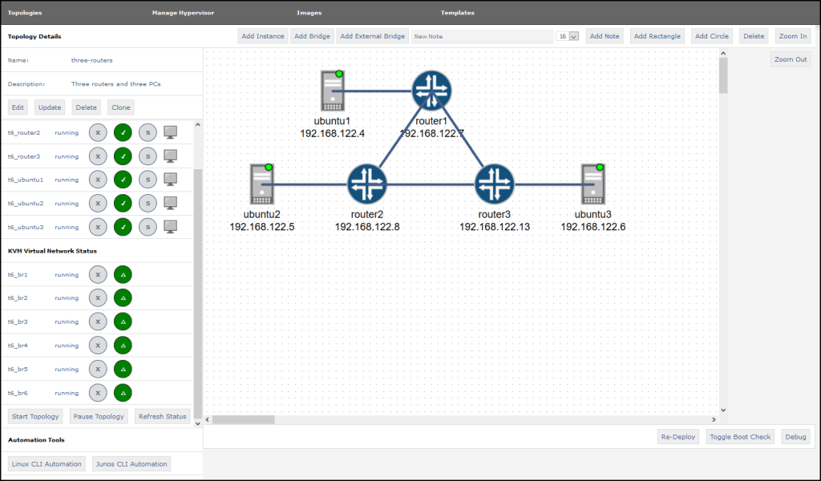
Network emulator
Notes:
Jupyter Wistar

Slide 9
Mininet
“Mininet is a network emulator which creates a network of virtual hosts, switches, controllers, and links. Mininet hosts run standard Linux network software, and its switches support OpenFlow for highly flexible custom routing and Software-Defined Networking.”
Source: www.mininet.org

Slide 10
Mininet (2)
Originally designed for research in Software Defined Networking and OpenFlow
Based on process abstraction in Linux and network namespaces
  Process ≈ Code + Data in memory (isolated from other processes by the OS)
Traditional OS-approach for networking: All processes share
  Network interfaces
  Routing tables
  ARP tables
Linux Network Namespace: Each process has own interfaces, routing tables and ARP tables
  So one process can emulate an entire host/switch/router/...
  And communicate with other processes similar to real network nodes

Slide 11
Mininet-WiFi
Standard Mininet with additional WiFi functionality
Uses standard Linux WiFi drivers
  Standard Linux commands can be used for network configuration
Supplementary reading: Fontes, Ramon R., et al., “Mininet-WiFi: Emulating Software-Defined Wireless Networks”, Proc. 11th international Conference on Network and Service Management, Cnsm 2015, 2015.
  DTU Library: https://findit.dtu.dk/en/catalog/2501698212

Slide 12
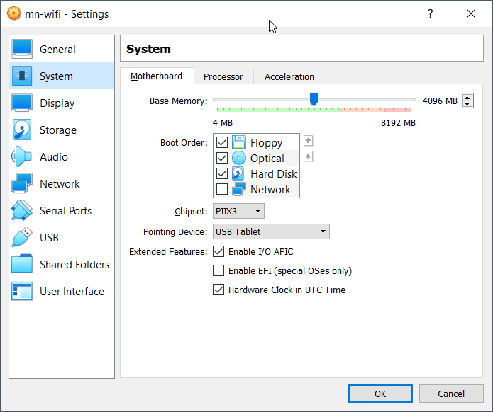
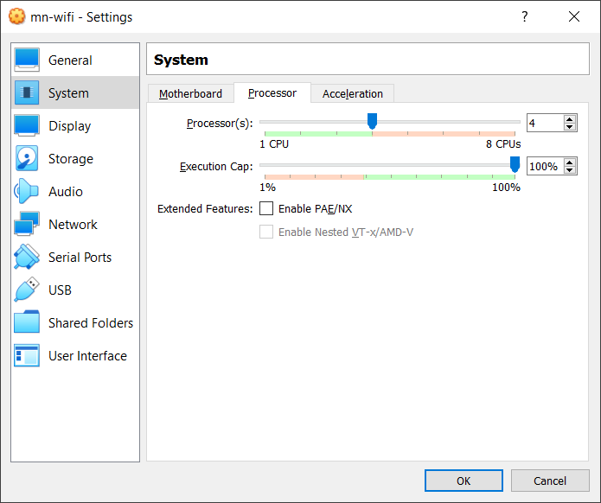
Configure the VM for best performance
Maximize available memory and CPU:
  Select the VM (VM34351v2) in VirtualBox’s window (left) and click on Settings (top)

Slide 13
Linux tips and tricks
Course 34351 Access- and Home Networks

Slide 14
Disable Linux’s built-in network manager
Linux has built-in network manager for autoconfiguration of network interfaces, associating with WiFi networks, obtaining IP-addresses via DHCP, etc.
Very nice for the ordinary user - but can be a royal pain in the a.. (pardon my french) if you want to control network interfaces manually (like in this exercise)
So a good habit is to disable it everytime you boot the virtual machine
  Open a terminal (double-click on ‘Terminal Emulator’) and execute
  sudo systemctl stop NetworkManager.service

Slide 15
Miscellaneous
Changing keyboard layout:
  Click on “mouse” at the top left and select Settings => Keyboard
  Keyboard layout can be changed under the Layout tab
Changing the display resolution
  Click on “mouse” at the top left and select Settings => Display
  Select a suitable resolution for your computer and click Apply
    And click “Keep ...” in the next dialog box if the resolution is to your liking
The application Screenshot (under Accessories) can be used to make screenshots
Wireshark can save captured traffic in *.pcap files for processing later
  Even in your host OS if you have installed Wireshark here (but who hasn’t?)

Slide 16
Sharing files between the VM and the host
Solution #1: Use the browser in the VM to upload files (screenshots, capture files from Wireshark, ...) to your cloud drive (Google Drive, Onedrive, ...) and use a browser in the host OS to download them again

Slide 17
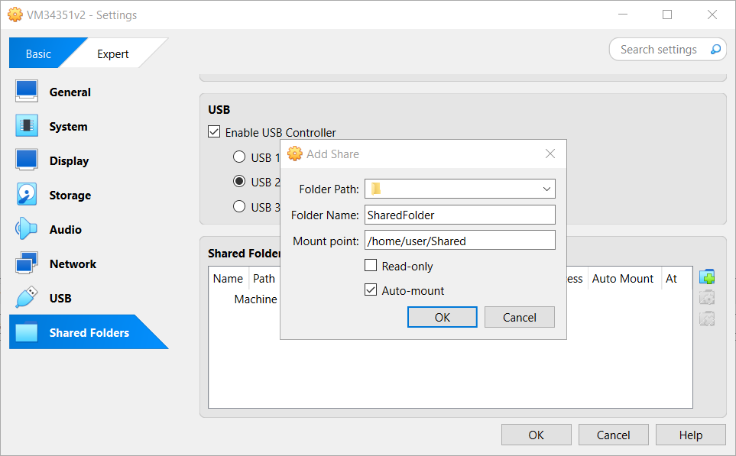
Sharing files between the VM and the host
Solution #2: Set up a shared folder between the host OS and the VM:
  Create a new folder in your host OS for sharing files with the VM
  When the VM is shut down: Select the VM, choose Settings, choose Shared Folders
    1) Click on “Folder icon with a green plus”
    2) Configure:
      Folder path: Full path of the new folder
      in your host OS
      Foldername: Anything but the name
      of the folder in the host OS
      Mount point: “/home/user/Shared”
      Check “Auto-mount”
  After start of the VM: You should be able
  to share files in the Shared folder in the VM
①
②

Slide 18
Mininet-WiFi tutorial
Course 34351 Access- and Home Networks

Slide 19
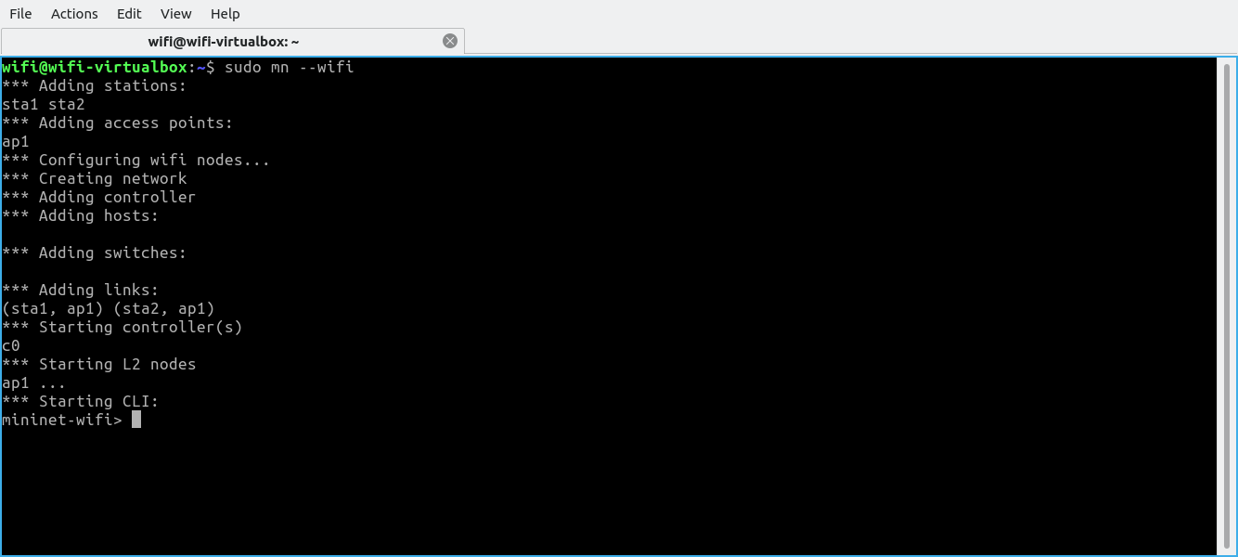
Mininet-WiFi tutorial (Step 1)
Start a terminal window and enter the command: sudo mn --wifi
Try to decode the output
Congratulations: Now you have a small WiFi network with an Access Point (ap1) and two stations (sta1 and sta2) running inside your computer

Slide 20
Mininet-WiFi tutorial (Step 2)
You can run Linux commands on the individual network nodes from the CLI:
  ap1 ip address show
    Runs the ‘ip address show’ command on the ap1 network node (displays IPv4 and IPv6 addresses assigned to any interface of the ap1 network node)
  sta1 ip link show
    Runs the ‘ip link show’ command on the sta1 network node (displays interfaces of the sta1 network node
  etc.

Slide 21
Mininet-WiFi tutorial (Step 3)
Check connectivity: Use the command pingpair at the CLI
Can sta1 and sta2 communicate?
What are the IPv4-adresses of the stations? (Focus on the (wireless) link between the stations and the access point)
  sta1?
  sta2?

Slide 22
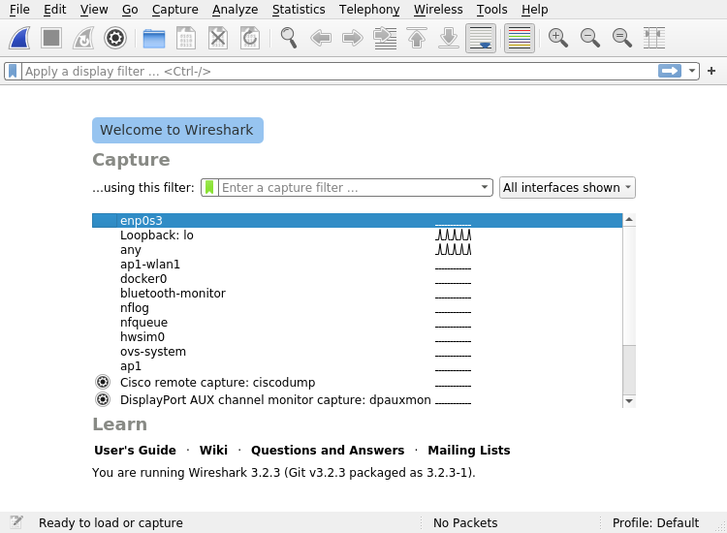
Mininet-WiFi tutorial (Step 4)
Start a new shell (Ctrl+Shift+T for a new tab or Ctrl+Shift+N for a new window)
  In the new shell, start the Wireshark packet sniffer program: sudo wireshark

Slide 23
Mininet-WiFi tutorial (Step 5)
Double-click on the ap1-wlan1 interface to start capturing traffic from this interface
In the Mininet-WiFi CLI: sta1 ping sta2
  Press Ctrl-C after some seconds to stop pinging
Switch to Wireshark and stop the capture
Look at the packets captured – are they as expected?

Slide 24
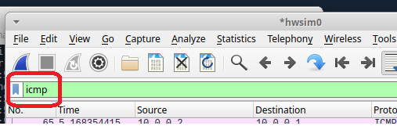
Mininet-WiFi tutorial (Step 6)
Enable the hwsim0 interface:
  In the Mininet-WiFi CLI: sh ip link set dev hwsim0 up
Start a new capture in Wireshark using the hwsim0 interface
Generate ping-traffic as before - Stop the wireshark capture and look at the packets captured – what is different from the previous capture?
  Don’t worry if you don’t understand
  what the extra packets are all about –
  we’ll cover that in next week’s lecture
Enter icmp in Wiresharks display filter:
  Why are you seeing two ping requests
  and two replys every time?
Close Wireshark when you’re done

Slide 25
Mininet-WiFi tutorial (Step 7)
Start an Xterm session on sta2: xterm sta2
  Use Ctrl + Rightclick in the xterm window to change font size
  In the Xterm window you can execute Linux commands directly
  without prepending the name first
In the xterm window for sta2:
  Determine the IPv4 address of the sta2 node
  Start an IPerf server with iperf -s
In the normal Mininet-WiFi CLI: sta1 iperf -c sta2
  Running this command takes approx. 10 seconds
  How would you interpret the output? What if you run the command multiple times?
  Use iperf -c “sta2’s IP-address” (without the quotation signs) if you run this in an XTerm on sta1
Note: We cannot start a program
in the background from the CLI,
so we’ll start an Xterm window
first (on the relevant host) where
we can execute the program.

Slide 26
Congratulations – You have completed the Mininet-WiFi
tutorial and are now ready for the exciting two-part
Mininet-WiFi exercise starting next week! ☺

